Slide 1


My summer
challenge
By Gwenllian Withers
And our plastic reduction

Slide 2
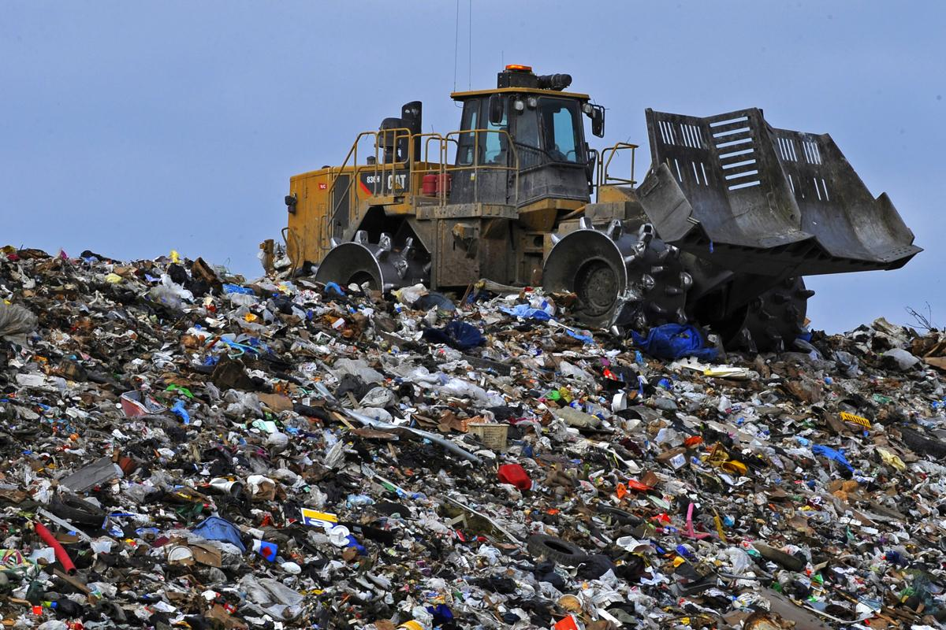
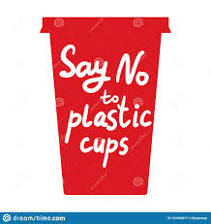
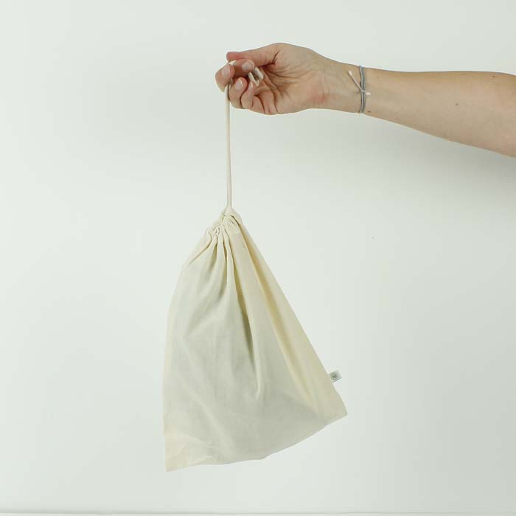
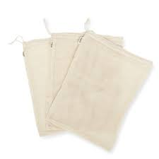
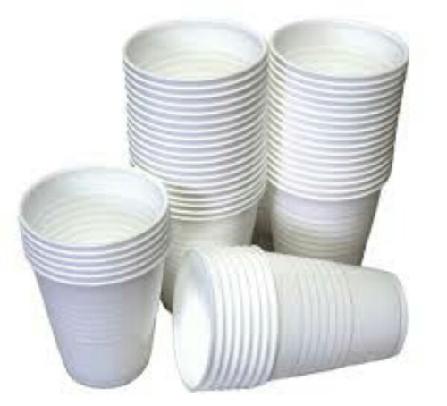

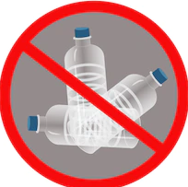
What we have already done
Even before the holidays our family have been trying to cut down on single use plastic by making some small changes which you will see in the next few slides. We go to ripple or iechyd-da-cf14 which are zero waste shops.We use metal straws so once we use them we clean them and then they can be used again.we also use Cloth bags that we use again and again and again.

Slide 3
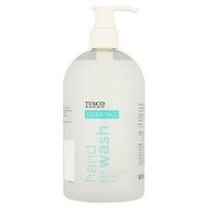
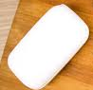
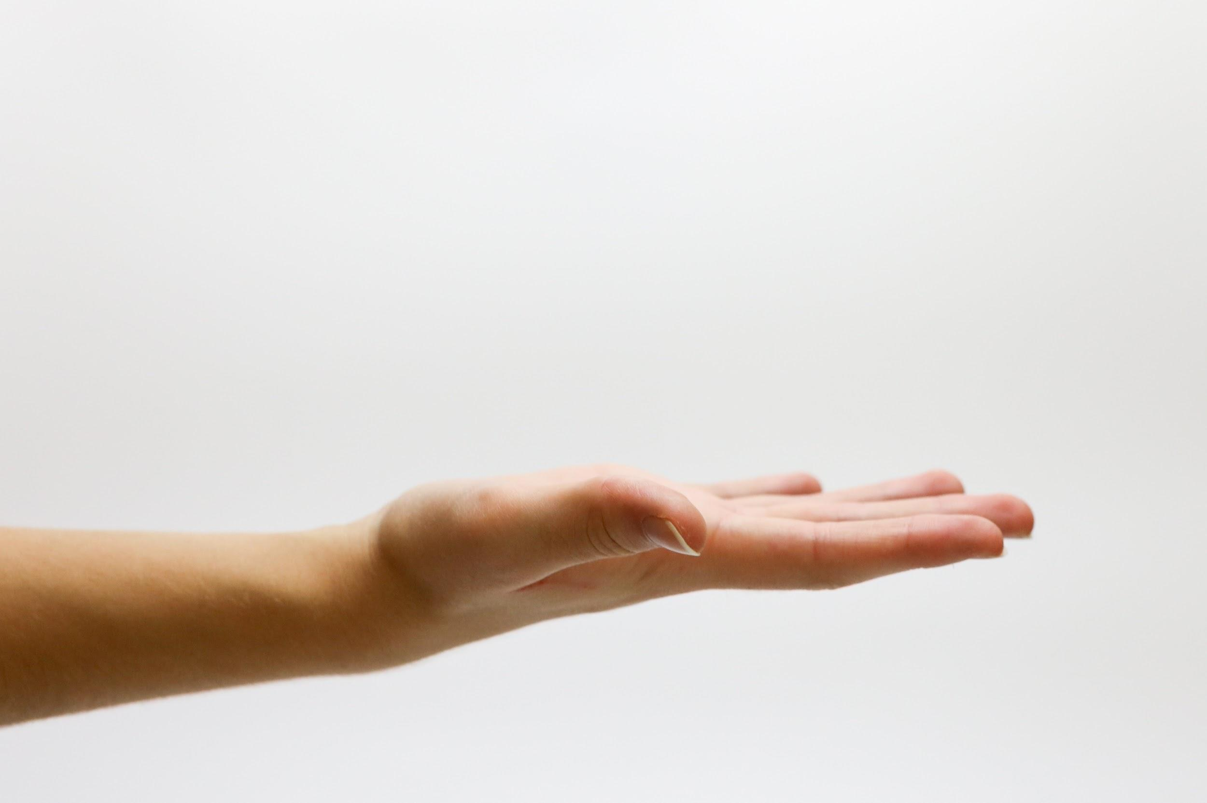
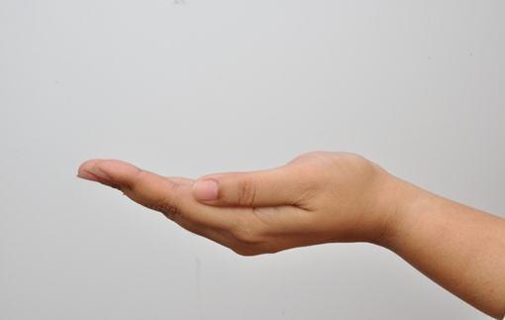
The First thing we did was change to soap bars
We used to use this
Now we use this

Slide 4
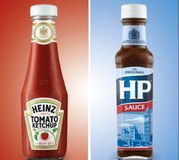
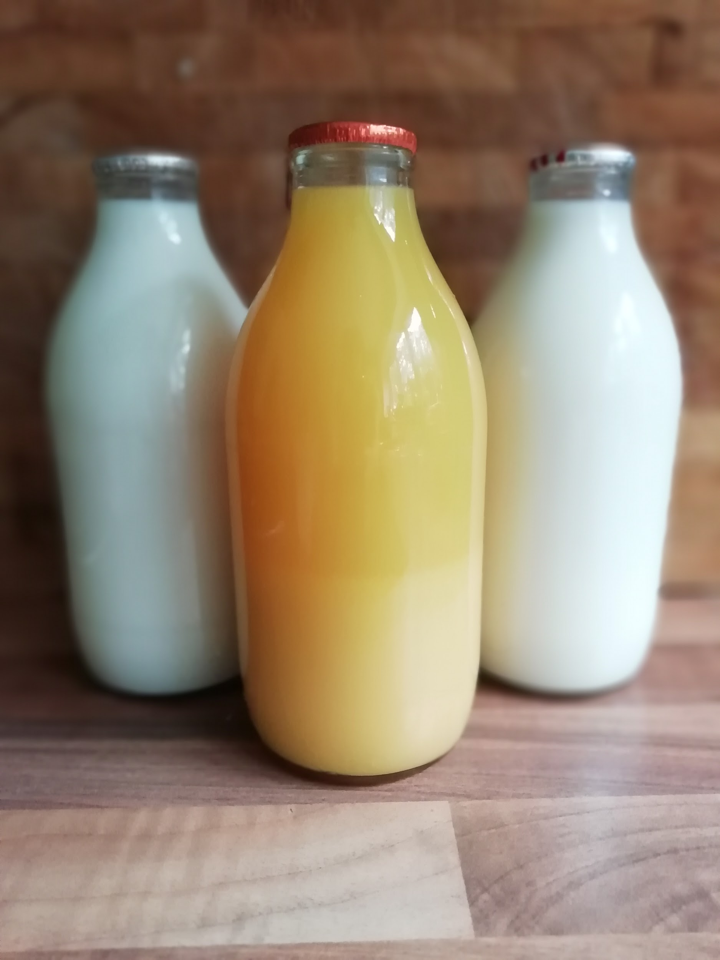
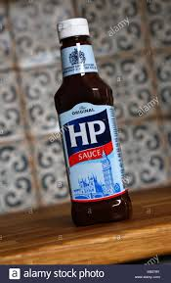
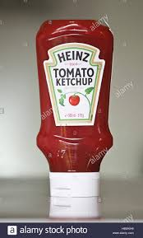
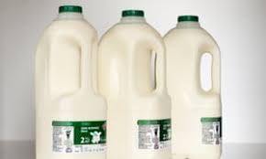
The second thing we did was change to glass milk, HP and ketchup bottles bottles
We used to use this
Now we use this

Slide 5
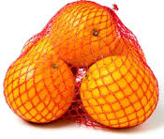
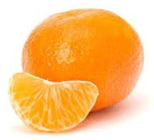
The third thing we did was change to
We used to use this
Now we use this

Slide 6
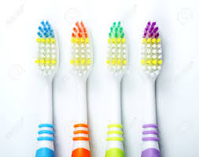
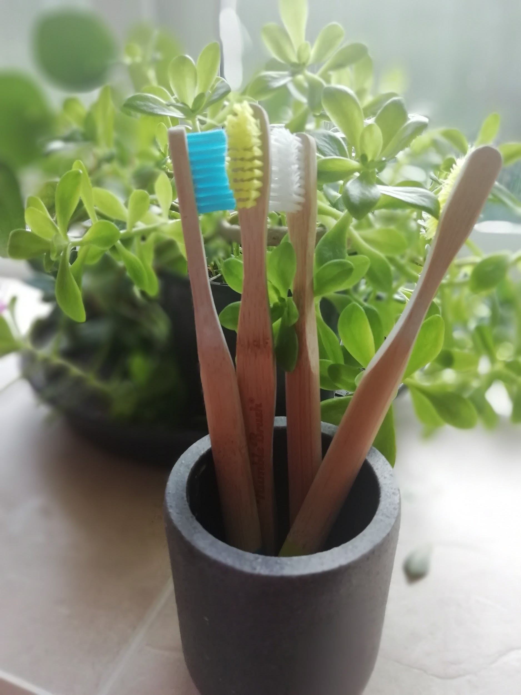
The fourth thing we did was change to bamboo toothbrush
Now we use this
We used to use this

Slide 7
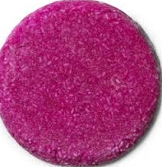
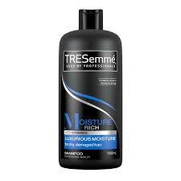
The fifth thing we did was change to
Now we use this
We used to use this

Slide 8
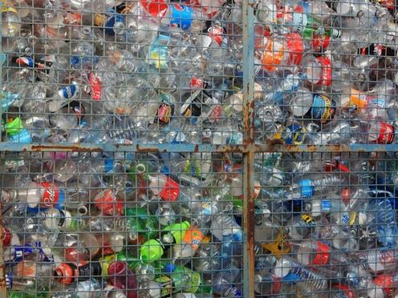
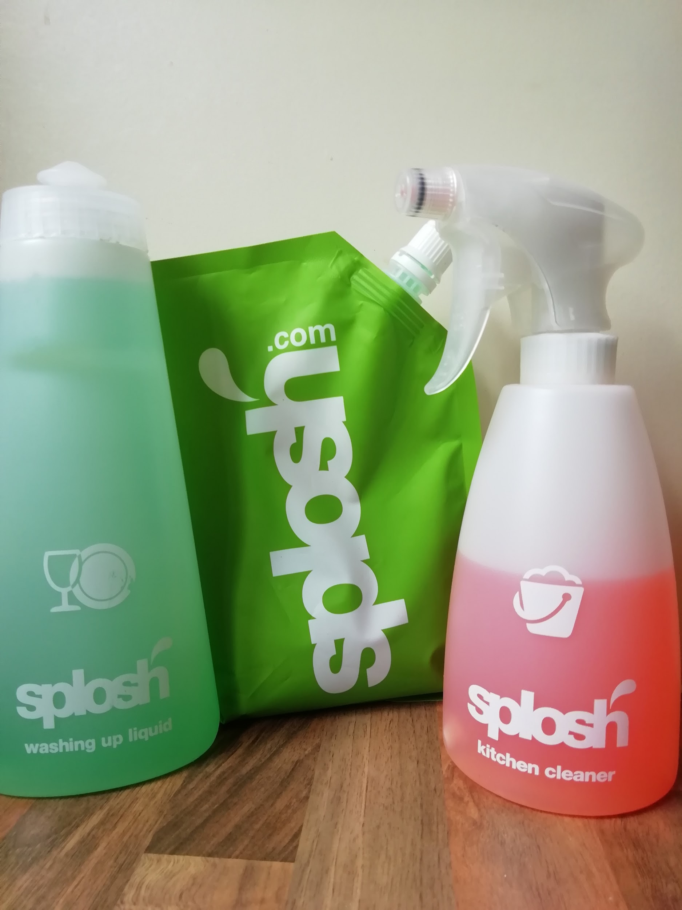
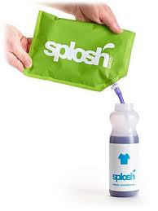
Splosh
Splosh is a company that makes cleaning products. When you first order a product it comes ready to use.Then you re-order the same product it comes in a concentrated pouch. The pouches get sent back to be recycled.

Slide 9

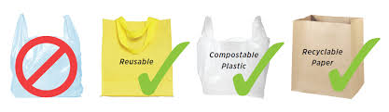
Where we want a solution
Cheese
yogurt
Chorizo
Wraps and bread,
toilet and kitchen roll,
marshmallows
All come in single use plastic

Slide 10
My challenge
For my summer challenge I went a whole day without plastic this is what i ate
Breakfast: waffles- icing sugar,demerara sugar,maple syrup,jam
(i would usually have marshmallows, squirty cream,yogurt,berries,chocolate spread, lemon juice and the above)
Lunch: homemade bread with scrambled egg and an orange
Dinner: burger(Homemade bun) red onion instead of cheese home made chips and baked beans
Pudding: A cadbury creme egg
we bought toilet roll wrapped in paper.
It was really hard i could not have any berris all day and there was barely anything I Could have on my waffles. My Brush and the toothpaste tube was the only plastic thing I used.
Notes:
My challenge

Slide 11
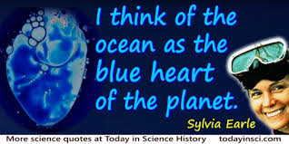
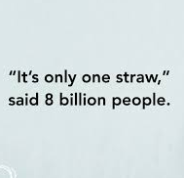
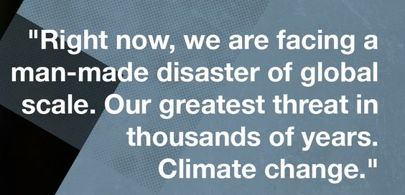
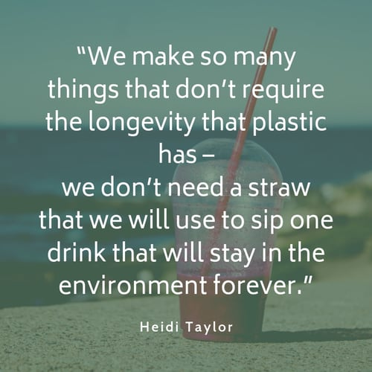
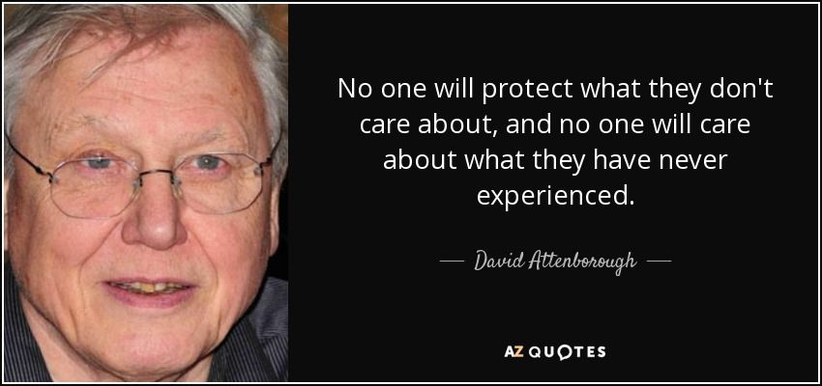
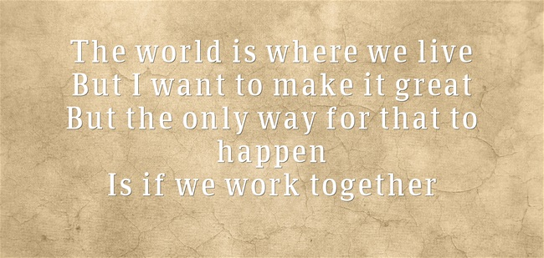

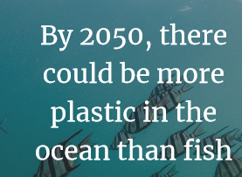
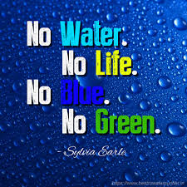
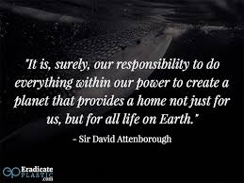
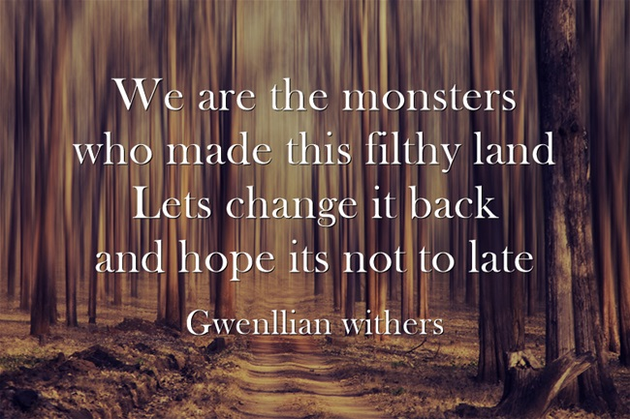
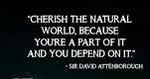

Slide 12
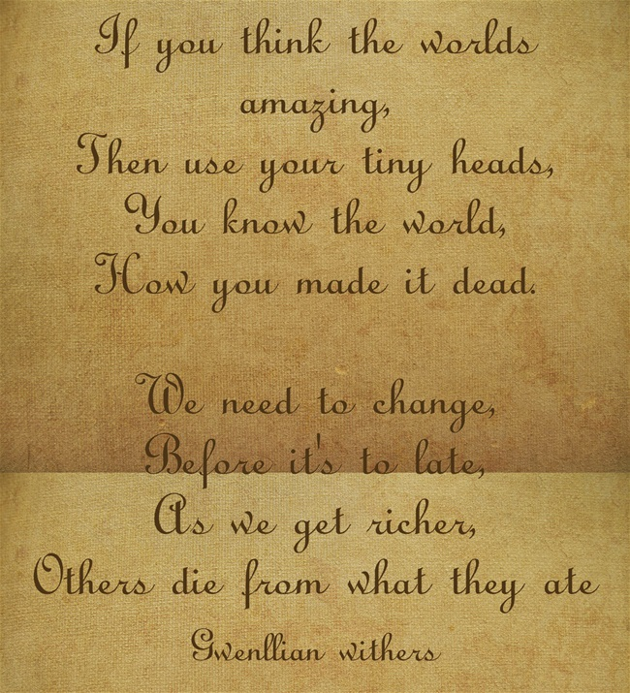
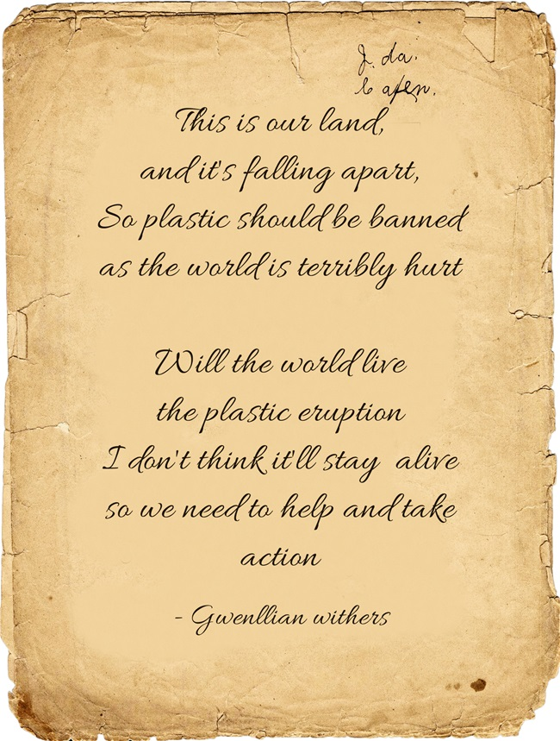
Poems
Here are 2 poems i made about our environment

Slide 13
My 5 Top Tips
My top tips to reduce single use plastic
Vist your own zero waste shops or greengrocers with your own bags and containers
Get soap,shampoo and conditioner bar
Get bamboo toothbrushes and toothpaste tablets
Get your milk from a milkman
Put you wraps/sandwiches in a container or use beeswax wrap

Slide 14
The Result
From our small changes we have saved
1052 bits of single use plastic a year
But if the whole school did the same we could save about
210400 bits of single use plastic a year

Slide 15
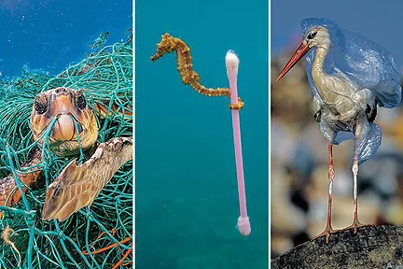
Links to some good websites
https://www.splosh.com/ link to splosh
https://www.seachangewine.com/ environment
https://www.recyclerebuild.org
https://www.scotsman.com/read-this/23-of-sir-david-attenboroughs-most-wise-and-inspirational-quotes/

Slide 16
Thanks For watching
I hope you enjoyed my speech and now have some great ideas to change this world and make it a better place. As i say.

