Slide 1
Climate Change
Definition: –
Scientists have discovered that humans are producing too much “Greenhouse Gas”, by burning “fossil fuels” such as Coal, Oil & Gas. This is causing the Earth to steadily warm up – known as Global Warming. The result of this warming is a change in the natural balance of the Earth’s environment”.

Slide 2
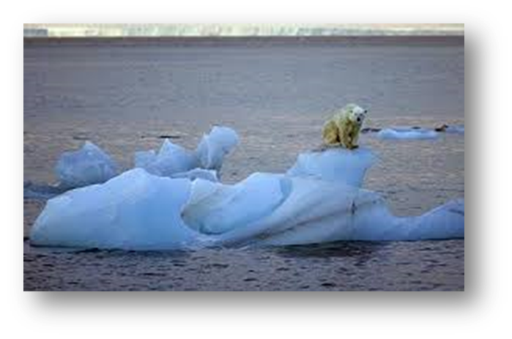
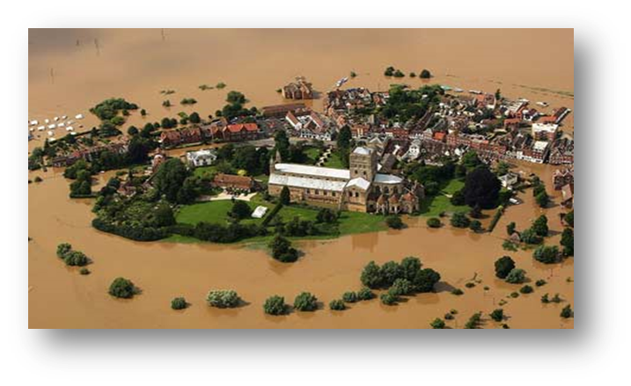
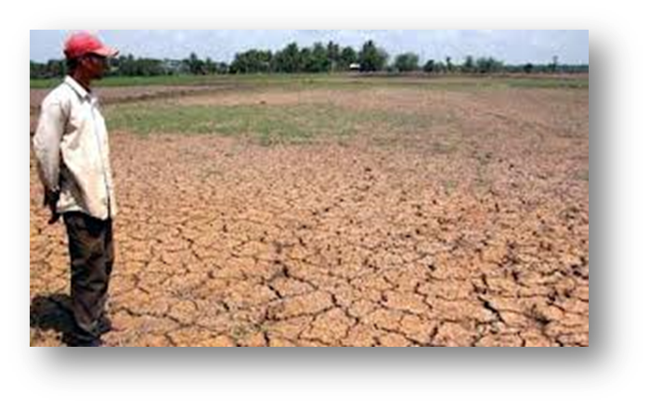
Global warming
Ice Caps Melting.
Rising Sea Levels.
More ‘Extreme’ weather events.

Slide 3
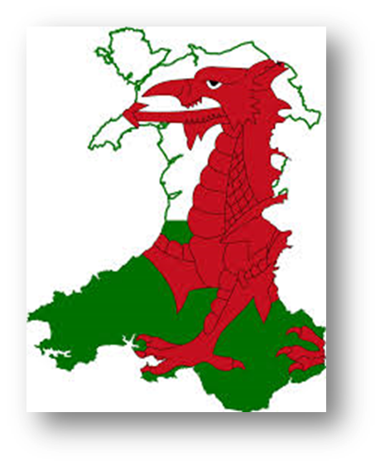
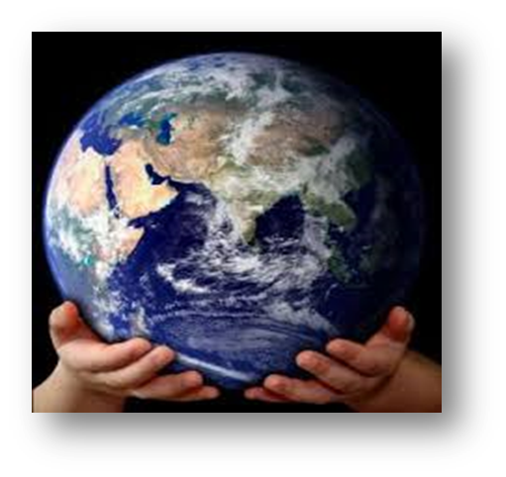
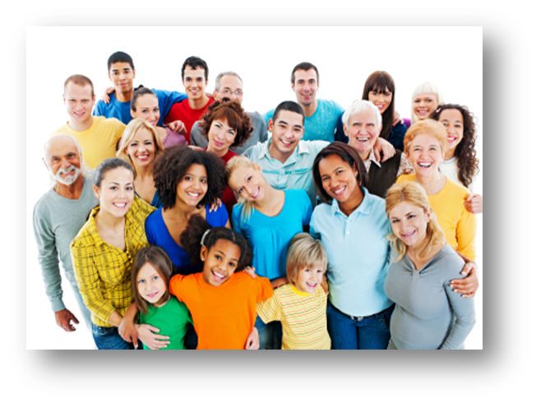
Who does Global Warming affect?
Everywhere and Everybody!

Slide 4
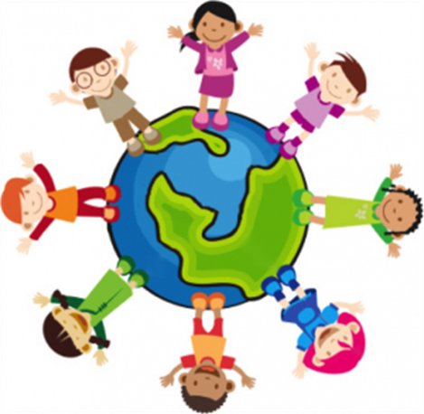
Ethical, Informed Citizens
Article 13: You have the right to have information

Slide 5

What can we do?
Reduce the energy we use
Use alternative transport
Reduce food miles and packaging
Reduce, Reuse, Recycle

Slide 6
Summer Holidays Eco Challenge
Go vegetarian or vegan for a day/week
Refuse plastic toys at fast food restaurants
Refuse plastic straws from any retailer
Save crisp packets at home to recycle in school
Use tea bags that don’t contain any plastic
Try not to use single use plastics
Try to use beeswax wraps
Don’t use products that are tested on animals
Use glass milk bottles from the milk man
Use reusable cups and bottles
Use glitter that does not contain plastic
Use shampoo or conditioner bars instead of buying it in bottles
Collect ink cartridges and batteries for school
Grow fruit or vegetables
Give old clothes/furniture to charity
Adopt an endangered animal
Recycle old garden pots at your local Garden Centre

Slide 7


